Slide 1
I/O Systems Lesson 4 Hardware Ops & STREAMS
David Liu
Fall 2021

Slide 2
Transforming I/O Requests to Hardware Operations
Consider reading a file from disk for a process:
Determine device holding file
Translate name to device representation
Physically read data from disk into buffer
Make data available to requesting process
Return control to process

Slide 3
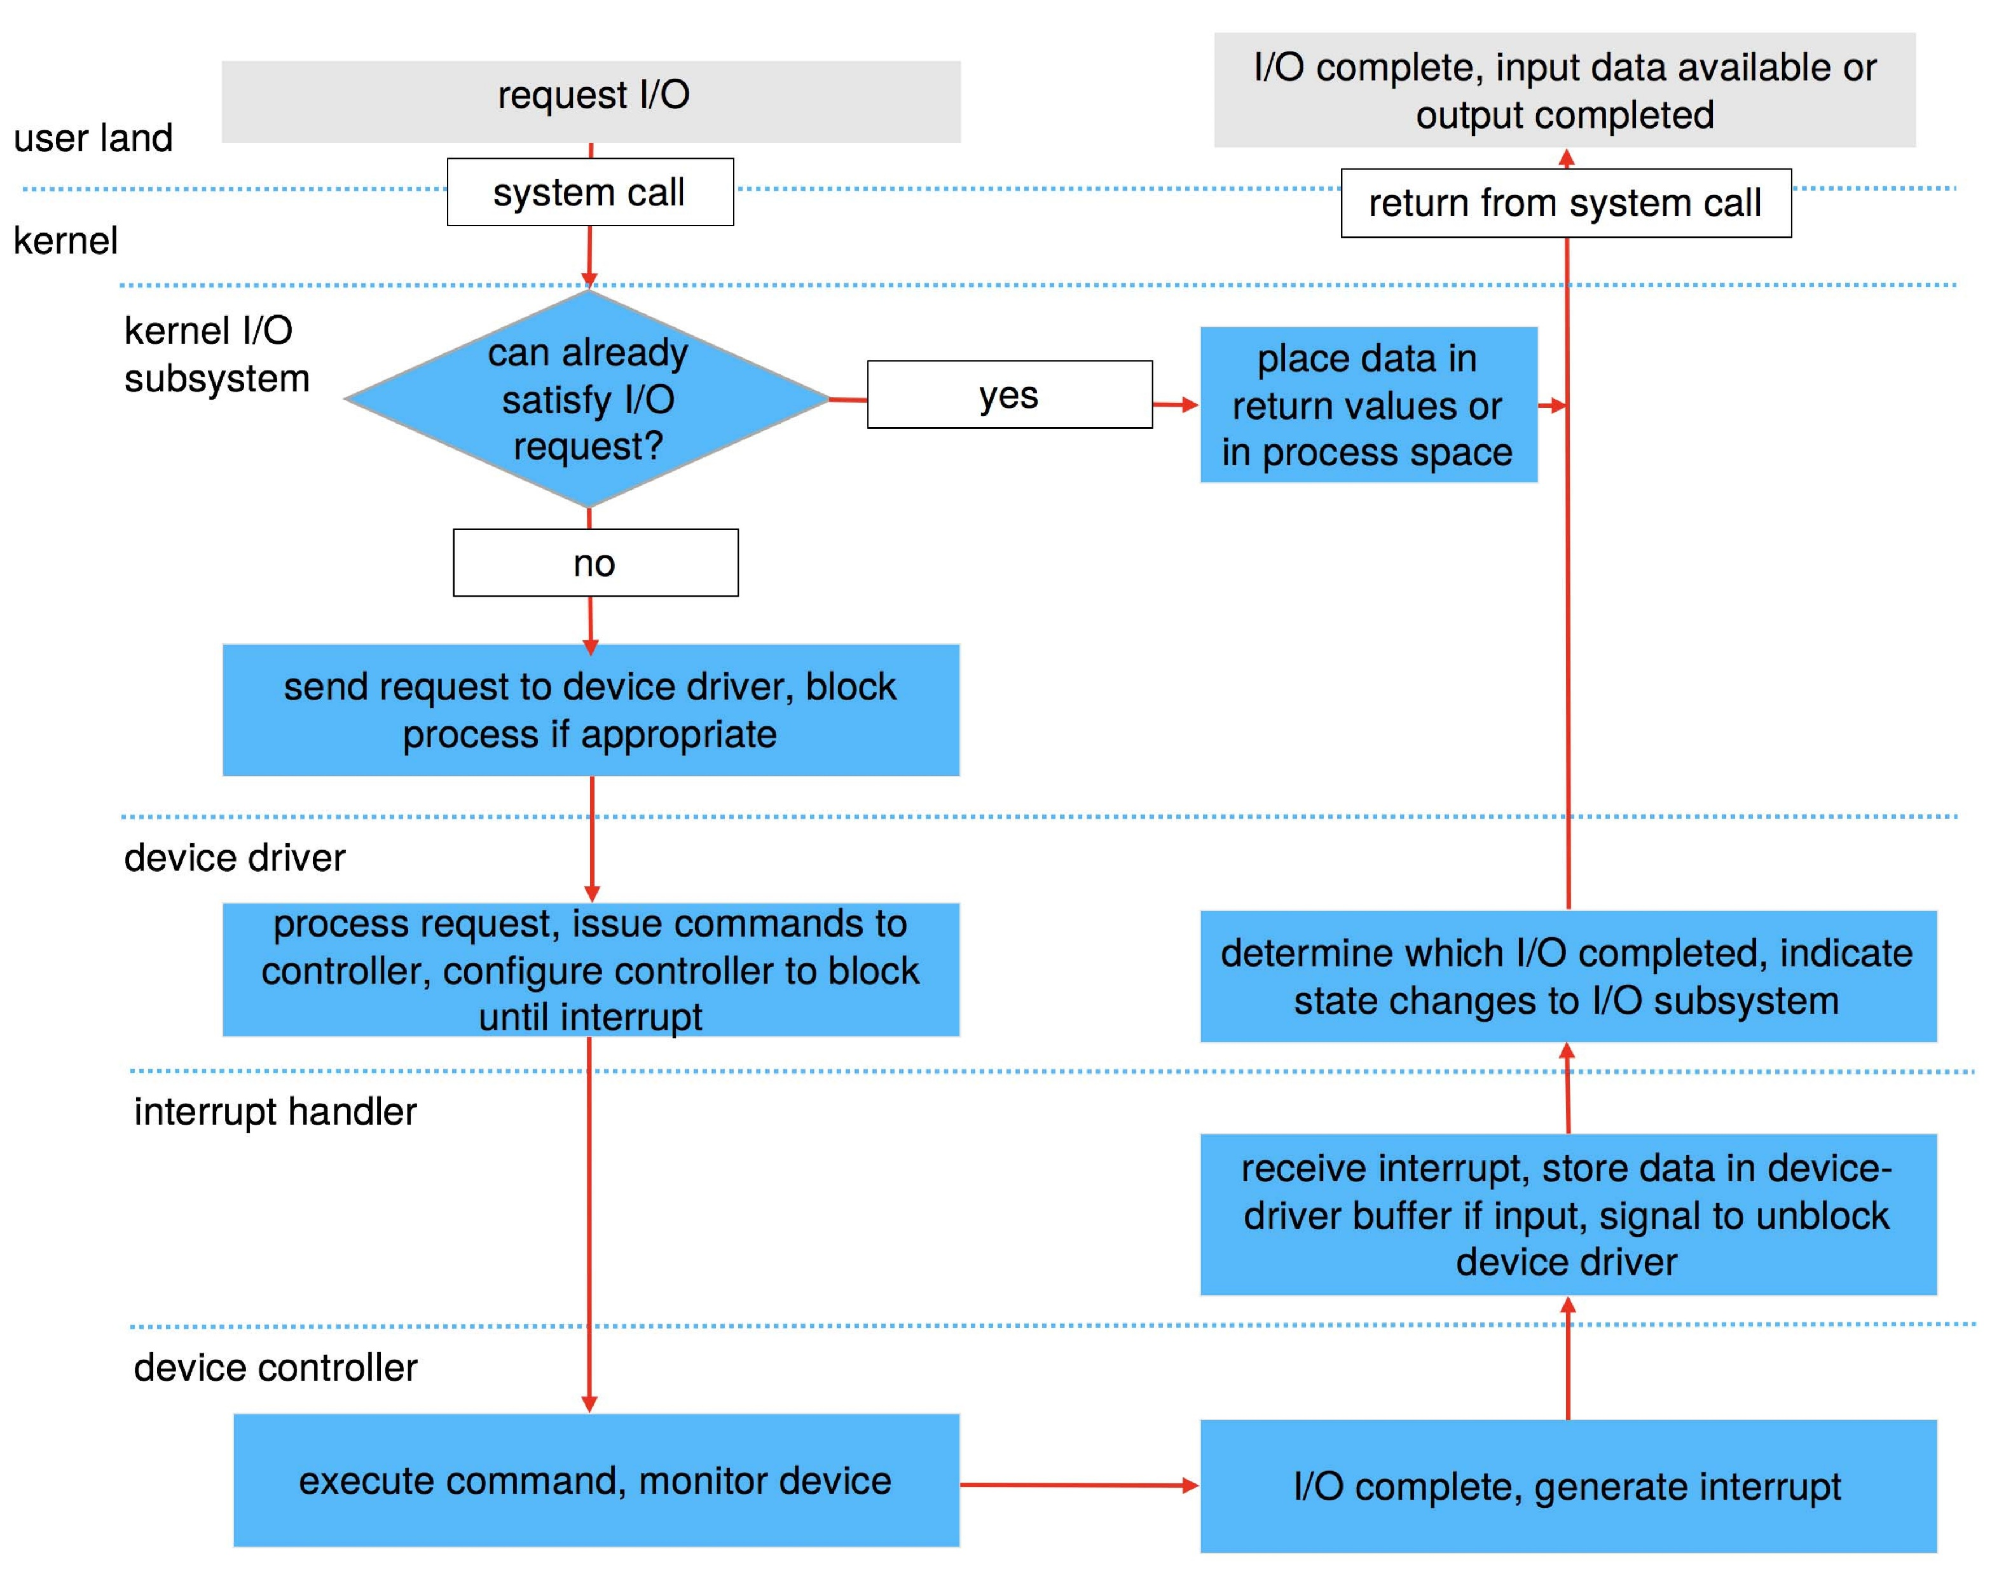
Life Cycle of An I/O Request

Slide 4
STREAMS
STREAM – a full-duplex communication channel between a user-level process and a device in Unix System V and beyond
A STREAM consists of:
STREAM head interfaces with the user process
driver end interfaces with the device
zero or more STREAM modules between them
Each module contains a read queue and a write queue
Message passing is used to communicate between queues
Flow control option to indicate available or busy
Asynchronous internally, synchronous where user process communicates with stream head

Slide 5
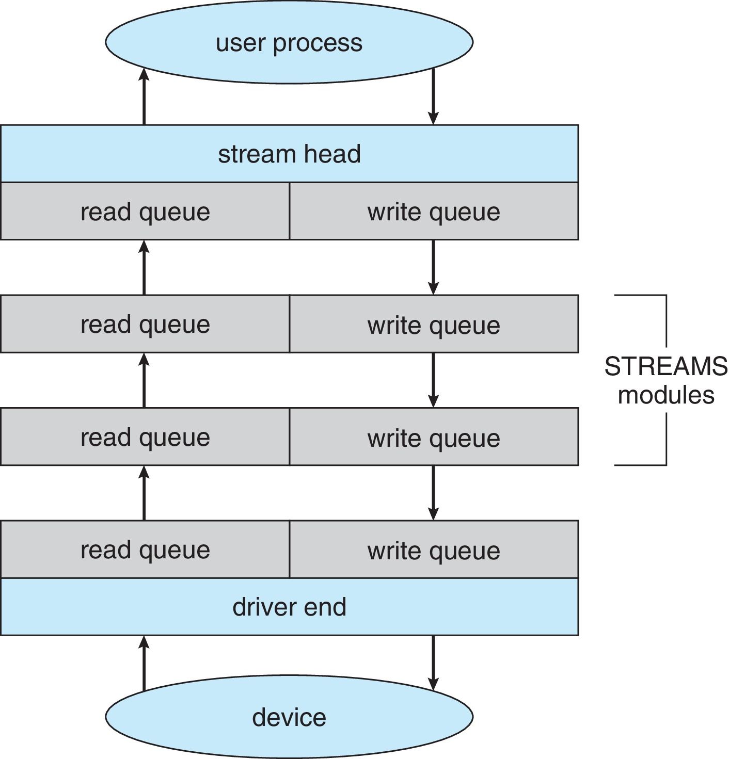
The STREAMS Structure

